Slide 1
Big Data Management
Project Presentation
Valentina Sisti
1952657

Slide 2

Domain of Interest
Music & Spotify Data
Songs
Artists
Albums
Genres
Record Labels
Music Charts
Notes:
The domain that I considered in my project is about Music Data and in particular data taken from one of the most popular streaming platforms that we have nowadays, which is Spotify, and data about lyrics that was from genius.
The first step was to collect the data,

Slide 3
Data collection phase
6 Datasets
14 CSV Files
Notes:
The domain that I considered in my project is about Music Data and in particular data taken from one of the most popular streaming platforms that we have nowadays, which is Spotify, and data about lyrics that was from genius.
The first step was to collect the data,

Slide 4

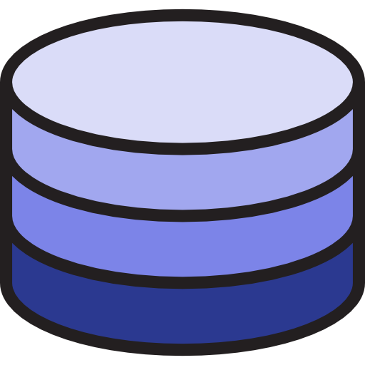

Data Collection Phase
tracks.csv
artists.csv
albums.csv
audio_features.csv
r_albums_artists.csv
8+M. Spotify Tracks Dataset
r_albums_tracks.csv
r_artist_genre.csv
r_tracks_artist.csv
Notes:
Once defined the domain of interest, the next step was actually to collect the data
And the first dataset I was able to collect data from is the 8 plus millions spotify tracks dataset, from which I collected 8 csv files about Spotify tracks, artists, albums and genres.
The first thing to point out from here is that since of course it would have been difficult to work on such a huge volume of data, and, most importantly, since, as we will see, the tasks in which we are interested are not concerning very unknown artists, my choice here and for the entire project, as we will see in the mapping, has been to consider just data relative to the artists with a certain value of popularity

Slide 5

Data Collection Phase
billboard-hot-100-tracks.csv
Billboard Hot 100 - Full History Dataset
Notes:
The second dataset contains just one CSV file about the full history of the Billboard Hot 100 chart, which is the music industry standard record chart in the United States for songs

Slide 6


Data Collection Phase
influence_data.csv
The Influence of Music, Spotify and AllMusic Data
Notes:
Another dataset that I found was The Influence of Music, Spotify and AllMusic Data, from which I collected just one single csv file about the influence between artists

Slide 7

Data Collection Phase
record_labels.csv
Record Labels - All Universal Music Group Artists
Notes:
The next dataset is about Record Labels of the Universal Music Group Artists, from which I collected one csv file about record labels of artists with associated their respective Group of Labels

Slide 8


Data Collection Phase
exp_track_genres.csv
SGTD_tracks.csv
exp_track_labels.csv
Exportify Data
Spotify and Genius Tracks Dataset
Notes:
And finally, the last two datasets are the one from Exportify and the Spotify and Genius Tracks Dataset, containing information about Spotify tracks and their associated labels and genres

Slide 9
Problems of the Data
Conceptual heterogenity
Concept of «id» may refer to Spotify ID, Billboard ID or custom ID internally defined
track_id and audio_feature_id are the same in tracks.csv
Songs’ duration stored in milliseconds
Albums’ release_date stored in epoch format
Notes:
Ok, now of course all these data that we collected has some problems.
While not presenting the problem of Physical Heterogenity, since all the data from the different sources is in the form of a CSV file,
there is however the problem of Conceptual Heterogeneity, so the fact that the different sources describe the domain from different perspectives.
In fact, for instance we may have the concept of ID that in some cases refers to the Spotify ID, in some other to the Billboard ID or even to some other custom ID internally defined
Then another problem is that in the tracks csv file there is the audio feature id, which is exactly the same of the track id, so basically is redundant information
Another problem is that Songs’ duration is stored in milliseconds, which is not very meaningful from our perspective, since we are used to look at songs’ duration in the minutes scale
And then also the Albums’ release date stored in epoch format, which is a format that from our perspective is not understandable at all

Slide 10
Problems of the Data (2)
Some data sources contain a huge volume of data
A great part of it refers to quite unknown artists and songs
In order to gain interesting insights, we want to restrict our discussion to just most relevant artists and songs
Notes:
Another problem of this data is that some of the data sources contain a really huge volume of data, in the scale of millions,
but the majority of it actually refers to pretty much unknown artists and songs.
So, also with respect to the tasks that we have identified, that do not concern very unknown artists,
we are not very interested a great part of this information and actually we want to restrict the discussion to just
more relevant artists and songs.
And in order to solve all these problems and to provide a reconciled view of these different data sources, what I have done was actually to define and Information Integration system and then to perfrom data integration using Talend as data integration tool.

Slide 11
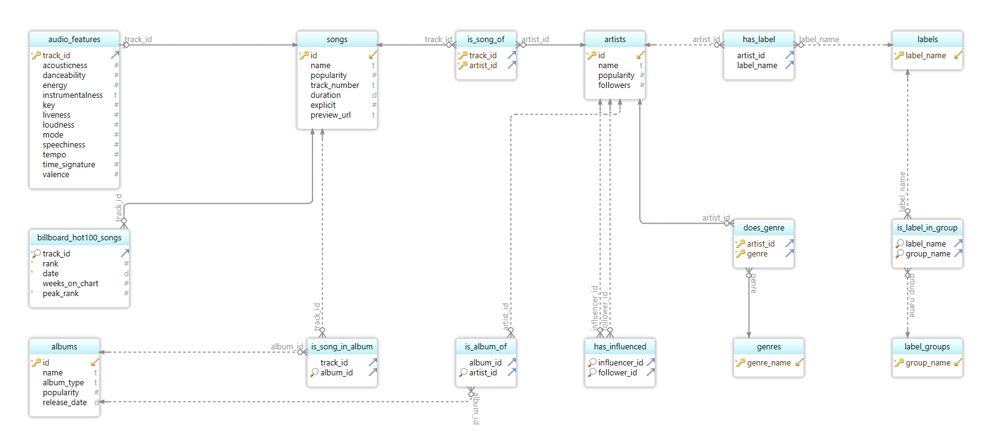
Resulting RDBMS
Notes:
And this is the representation of the resulting Relational DBMS that I obtained after the data integration process..

Slide 12
The need for a Graph Database
Relationships are very predominant in this domain
in a RBDMS we may need many joins when querying the data
RDBMS suffer of the so-called join pain phenomenon
Notes:
Now, if we give a close look to our data, we can immediately notice that a representation in a relational database form is not very well suited for the kind of data that we have, and this is due to the fact that relationships are very predominant in this domain (because we have information about songs, albums, artists, genres and so on, but of course we also need to store the relationships between these entities, so the fact that a song is performed by a certain artist, or that is present in a certain album and so on)
Being relationships so much predominant, this means that there could be the need of performing many joins when querying the relational database, and as we know relational databases suffer of the so-called join pain phenomenon, so the fact that if queries involve several tables by performing joins, we have that the performances of the queries decrease very much as the table sizes increase.
So, given all these considerations, we can well understand that a relational database is not very well suited and everything points towards a representation of our data in the form of a Graph Database, in which relationships are actually physically represented, so they do not need to be computed at query time as in RDBMS.

Slide 13
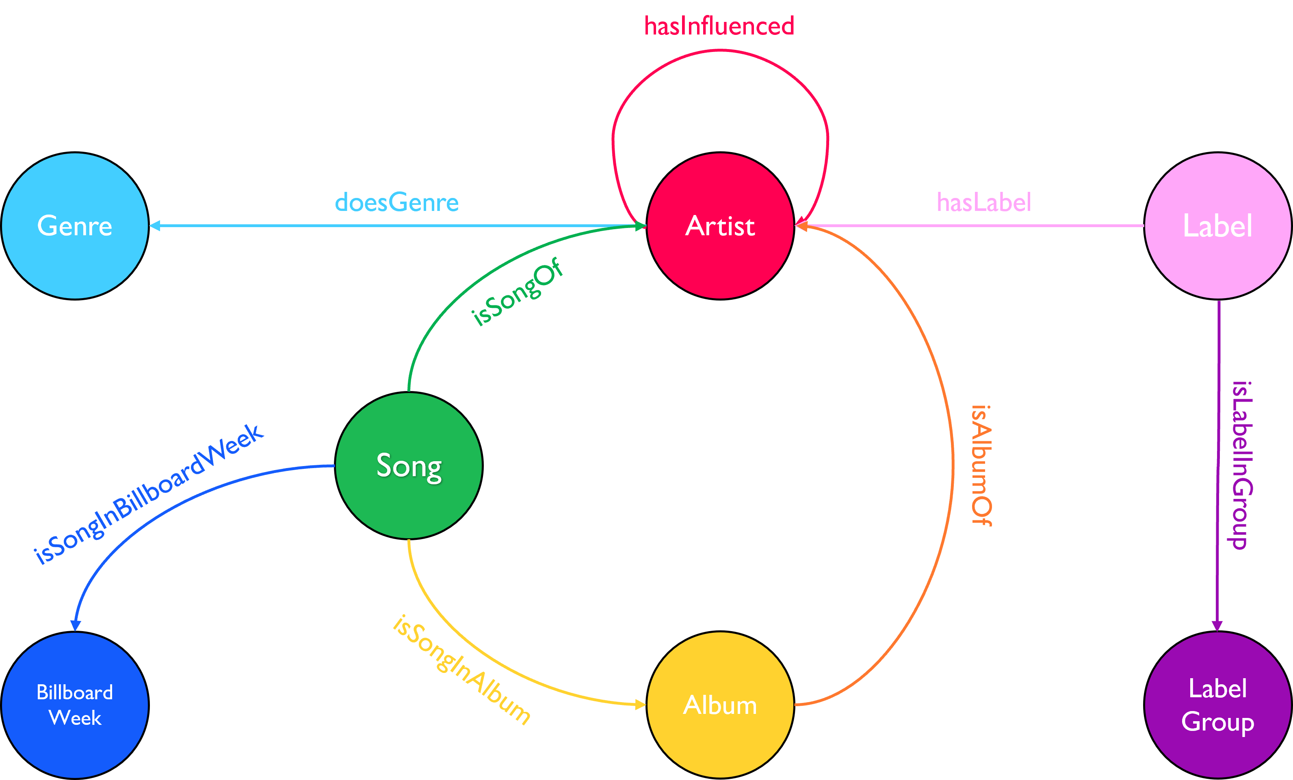
Property Graph Model
rank: int
peak_rank: int
weeks_on_chart: int
Notes:
Now that we decided which type of Graph Database is best suited to our data, we can finally define the model of our Property Graph, which is the one that we see here:
So we will model Songs, Artists, Albums, Genres … as vertices, and of course through the edges we will represent the relationships between all these entities, so the fact that a Song is performed by an artist, or that a Song belongs to a certain album, or that an Artist does a particular genre. What is less straightforward is maybe this BillboardWeek node, which, as the name suggests, represents a particular week of the Billboard Hot 100 Chart, and we have a relationships between the BillboardWeek and a Song when that song was present in the chart of that particular BillboardWeek, and since a song in the billboard week is present with the information about rank, peak rank and the number of consecutive weeks it was present in the chart, of course I needed to model these information as attributes of the relationship. Then we have the hasInfluenced relationship, which models the fact that an Artist has influenced, with his music, another artist, and also the isLabelInGroup relationship, because it could happen that a record label belongs to a group of labels, and so we need to model also this fact in our data.

Slide 14

Choosing a proper tool:
Multi-Model NoSQL DBMS
Combines power of graphs with flexibility of documents
Entirely written in Java
No configuration and installation
Community edition free for commercial use
Fully supports ACID transactions
Notes:
OrientDB is actually not only Graph Database but is what is called a Multimodel NoSQL DBMS, and in particular it combines the power of graphs with the flexibility of documents into one scalable operational databse.
It is entirely written in Java and can run on any platform without configuration and installation
It has a Community edition, which is free for commercial use and also an enterprise edition that provides enterprise level functionalities
Moreover it fully supports ACID transactions and also distributed transaction, as it supports a Distirbuted Multi-master architecture in which all the nodes are masters (while in most DBMS the replication works in Master-Slave mode where there is only one master

Slide 15
OrientDB: Multi-Model
OrientDB engine supports the following models:
Graph
Document
Key/Value
Object
and combines the features of the four models into the core
Notes:
As we said OrientDB is a Multi-Model DBMS, and this means in particular that its engine supports Graph, Document, Key/Value and Object models, and therefore can be used as a replacement for any of these categories.
But of course the main reason one could choose it is because it actually combines the features of the four models into the core, and the engine itself was built to support all the 4 models

Slide 16
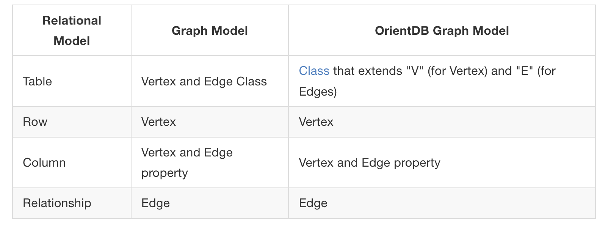
OrientDB as a Graph Database
Property Graph which defines:
Vertices
unique identifier
set of incoming edges
set of outgoing edges
Edges
unique identifier
link to an incoming Vertex
link to and outgoing Vertex
label
Notes:
Of course, since for the purpose of our discussion we are interested in the Graph model, let’s look at bit into its details
OrientDB’s Graph Model is represented by the concept of a Property Graph, that as we said is what we choose to consider for our purpose, that is defined by:
A set of Vertices, that has as mandatory properties a unique identifier, a set of incoming edges and a set of outgoing edges, and:
A set of Edges, that again have as mandatory properties a unique identifier, and this time a link to an incoming vertex, a link to an outgoing vertex and a label that defines the type of relationship between the head and tail vertices
In addition to mandatory properties of course each vertex and edge can also have a set of custom properties that can be defined by the user
This table actually shows a comparision between the relational model, the general graph model and the OtientDB’s graph model.
An as we can see here, what distinguished the OrientDB graph model by a general graph model is the fact that in OrientDB we have the concept of Class, which means that in OrientDB is defined a basic Class “V”, for vertices, which will be the parent class of any vertex class we are going to create in our databse, and the basic Class E, which which in turn will be the parent class for every Edge class we are going to define in the database

Slide 17
OrientDB Classes
Concept taken from OOP paradigm
Define records
Can be schema-less, schema-full or hybrid
Can inherit from other classes
Have one cluster defined as default cluster but can support multiple clusters
Notes:
The concept of class is taken from the Object Oriented Programming paradigm.
What classes do in orientDB is to define records (and a record is basically the smallest unit that can be loaded from and store into the database)
Moreover, classes can be schema-less, schema-full or hybrid (so a mix of the two)
They can also inherit from other classes, which means, in this context, inheriting all the attributes by the parent class
Then each class has one cluster defined as its default cluster, but it can support also multiple clusters.

Slide 18
OrientDB Clusters
Classes: logical framework to organize data
Clusters: physical (or in-memory) space where data is stored
Examples:
Cluster «cache»
containing most accessed records
Clusters «artists_it» , «artists_us»
containing data on artists from Italy and USA
Notes:
Going more into the details about clusters, basically while classes are a logical framework to organize the data, clusters are the physical (or in-memory) space where OrientDB actually stores the data
So a cluster is simply a generic way to group records, and in particualar can be used to group all records of a certain type or by a specific value (for instance we can use a cluster named “cache” to group the most accessed records or for instance, in our music domain, we could group the artists by country or by genre and so on)
When a new class is created, also the corresponding default physical cluster is created, and starting from OrientDB v2.2 are actually created multiple clusters in order to improve perfromance of parallelism

Slide 19
OrientDB Storages
OrientDB supports 3 storage types:
plocal → persistent, disk-based
remote → use of the network to access it
memory → all data remains in memory
Each storage is composed of multiple clusters
Notes:
Regarding the storage, OrientDB supports 3 storage types:
Plocal, which is the persistent, disk-based storage
Remote, so we can use the network to access a remote storage, and
Memory, in which all data remains in memory
And each storage is composed of multiple clusters

Slide 20
OrientDB Query Language
Since SQL is the most widely recognized standard, OrientDB uses SQL as its basic query language
OrientDB then enhances SQL with some extensions to enable graph functionalities
Notes:
Since when it comes to query languages, SQL is the most widely recognized standard, and of course the majority of developers have experience and are comfortable with SQL, what OrientDB does is not actually defining a complete, new, query language, rather it uses SQL at the basis of its query language and it enhance it with some extensions to enable graph functionalities, so that, even though there are a few differences between the standard SQL syntax and the one supported by OrientDB, for the most part it should feel very natural to use it.

Slide 21
OrientDB’s SQL Dialect
The classic JOIN syntax of SQL is not supported in OrientDB
Relationships are represented as LINKs instead of JOINs
The * in projections is optional
Writing SELECT * FROM Song and SELECT FROM Song is equivalent
Does not support the HAVING keyword
OrientDB allows to SELECT only from one class
SELECT FROM Song,Album cannot be done in OrientDB
Notes:
What OrientDB does is actually define a real SQL dialect, as they call it, which the basic concepts are the following:
First of all, the most important difference is that in OrientDB relationships are represented as LINKS instead of JOINs, so the classic JOIN syntax of SQL is not supported in OrientDB
#TODO: continua da http://orientdb.com/docs/3.1.x/sql/SQL-Introduction.html

Slide 22
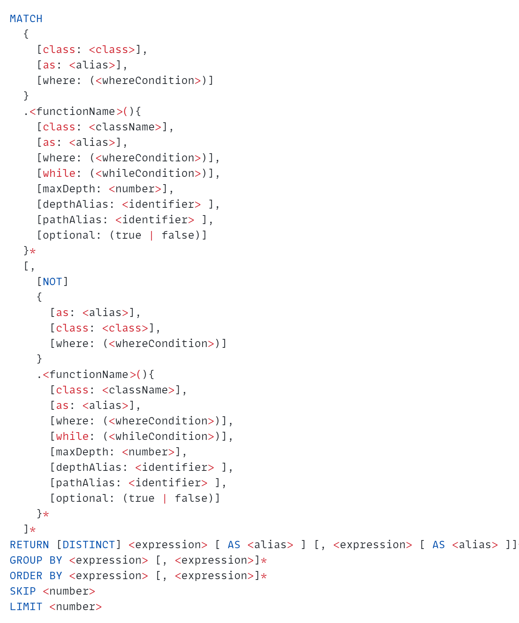
MATCH clause
Queries the database in a declarative manner, using pattern matching
Notes:
Then, the most important clause that the OrientDB query language introduces in order to allow graph functionalities is the MATCH clause, that allows to query the database in a declarative manner, using pattern matching.
This is the general syntax thorugh which we can use the MATCH clause, taken from the OrientDB documentation.
But I think it is better to really show the expressive power of the OrientDB language through the demo, so thorugh some queries that I defined over the data from our Music Domain. So we can now move to the Demo.

Slide 23

DEMO

Slide 24
Property Graph VS Triple Store
in RDF it will contain 11 x n triples
When we have a 100 millions triple graph, that same data will probably be equivalent to labeled property graph with 10 millions nodes
Take a graph with n nodes
5 properties per node
5 relationships per node
1 label per node
Notes:
Now that we understood that is best to use a Graph Databse, we need to choose which kind of Graph Database, so decide whether is best to use a Triple store or a Property Graph, and also in this case we can do some considerations. In fact, we know that of course both of them are very good when relationships in the data are predominant, but we know that Triple stores of course stores the relationships as triples of subject-predicate-object, and
esempio: it was natural, by looking at the dataset, to think about a Property Graph rather than a triple store graph (RDF), and this is because RDF è more suited quando sono predominanti sì le relazioni, ma gli elementi che compaiono in queste relazioni non compaiono tipo in 500 relazioni diverse → nel mio caso per esempio un artista può aver fatto 80000 canzoni e anche un album contiene sulle 10/20 canzoni, anche riguardo l’influenza, uno stesso artista può aver influenzato tanti artisti diversi e stessa cosa un’etichetta può essere l’etichetta di tanti artisti. Stessa cosa per i generi. Anche per le canzoni, anche se nella maggior parte dei casi una canzone è cantata da un unico artista, sono comunque parecchi i casi in cui le canzoni sono dei featuring, e in alcuni casi ci sono anche canzoni in cui hanno partecipato, 5/6 artisti o cose così. Quindi tutto ciò ci “porta via” (which moves us away from da una rappresentazione del nostro dataset via RDF e tutto punta verso un Property Graph, che, fatte queste considerazioni, è decisamente il miglior modo per rappresentare il nostro database, dal momento che possiamo rappresentare una certa entità solamente una volta (rispetto a RDF, in cui dobbiamo
-> From what is know, a Triple Store is best suited when we have a slow-changing dataset and from what is known they do not scale very well: in fact they are most used in when we want to “derive” ontologies

Slide 25
Property Graph VS Triple Store: Attributes of Relationships
Property Graph
Triple Store
‘Numb’
17
5
isSongInBillboardWeek
rank: 17
peak_rank: 5
weeks_on_chart: 6
name
rank
peak_rank
Song
Billboard Week
86
popularity
‘abc123’
isSongIn Billboard Week
from
to
‘2017-07-28’
id: ‘abc123’
Name: ‘Numb’
Duration: ‘00:03:53’
Popularity: 86
Week_of_date: ‘2017-07-28’
duration
weeks_on_chart
’00:03:53’
6
Notes:
We would like to model the information about songs that are present in the Billboard Chart in this way, so by defining an isSongInBillboardWeek relationship between the specific Song and BillboardWeek.
But the problem is that in this relationships we have also other information that we want to have in our database, in particular the rank at which this song has positioned in the chart and also the peak_rank it has reached
for the whole period of time it has been consecutively present in the chart.
And while we can easily do this in a Property Graph by defining this information as attributes of the relationships, this is not actually true with triple store, because in order to do this we would need to use reification in this way.
So, as we can see, this is way more compact to be done in a Property Graph.

Slide 26
Which type of Graph Database?
Triple Stores
best suited when we have a slow-changing dataset
from what is known, they do not scale very well
most used in when we want to derive ontologies
Notes:
Now that we understood that is best to use a Graph Databse, we need to choose which kind of Graph Database, so decide whether is best to use a Triple store or a Property Graph, and also in this case we can do some considerations. In fact, we know that of course both of them are very good when relationships in the data are predominant, but we know that Triple stores of course stores the relationships as triples of subject-predicate-object, and
esempio: it was natural, by looking at the dataset, to think about a Property Graph rather than a triple store graph (?) (RDF), and this is because RDF è more suited quando sono predominanti sì le relazioni, ma gli elementi che compaiono in queste relazioni non compaiono tipo in 500 relazioni diverse → nel mio caso per esempio un artista può aver fatto 80000 canzoni e anche un album contiene sulle 10/20 canzoni, anche riguardo l’influenza, uno stesso artista può aver influenzato tanti artisti diversi e stessa cosa un’etichetta può essere l’etichetta di tanti artisti. Stessa cosa per i generi. Anche per le canzoni, anche se nella maggior parte dei casi una canzone è cantata da un unico artista, sono comunque parecchi i casi in cui le canzoni sono dei featuring, e in alcuni casi ci sono anche canzoni in cui hanno partecipato, 5/6 artisti o cose così. Quindi tutto ciò ci “porta via” (which moves us away from da una rappresentazione del nostro dataset via RDF e tutto punta verso un Property Graph, che, fatte queste considerazioni, è decisamente il miglior modo per rappresentare il nostro database, dal momento che possiamo rappresentare una certa entità solamente una volta (rispetto a RDF, in cui dobbiamo
-> From what is know, a Triple Store is best suited when we have a slow-changing dataset and from what is known they do not scale very well: in fact they are most used in when we want to “derive” ontologies

Slide 27
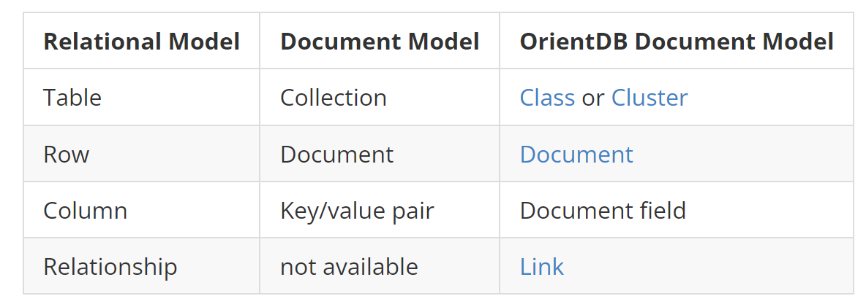
OrientDB: Document Model
A document is a set of key/value pairs
Values can hold primitive data types, embedded documents, or arrays of other values
Documents are stored in collections enabling developers to group data as they decide. OrientDB uses the concepts of "classes" and "clusters" instead of "collections" for grouping documents
OrientDB's Document model adds the concept of a "LINK" as a relationship between documents.
Notes:
Clusters: Each cluster is one file at file system level. It is comparable to the "collection" in Document databases and to the "table" in Relational databases
Vertices are themselves documents with some additional features. This means they can contain embedded records and arbitrary properties exactly like documents

Slide 28
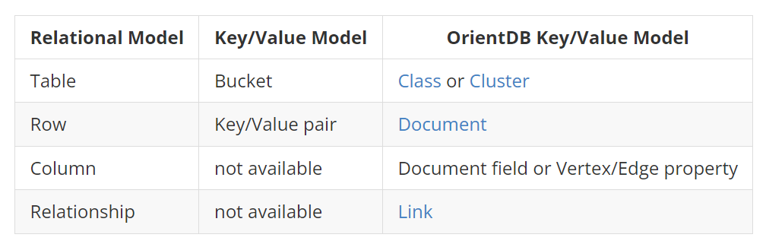
OrientDB: Key/Value Model

Slide 29
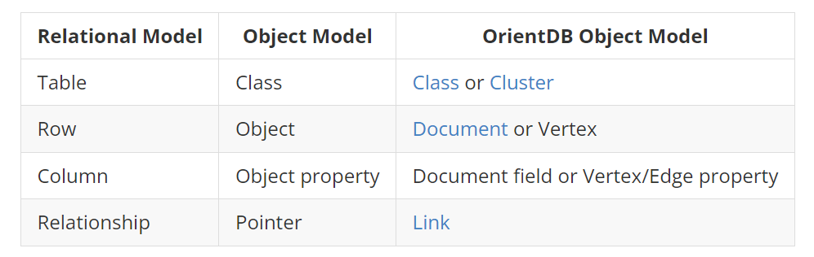
OrientDB: Object Model

